Slide 1
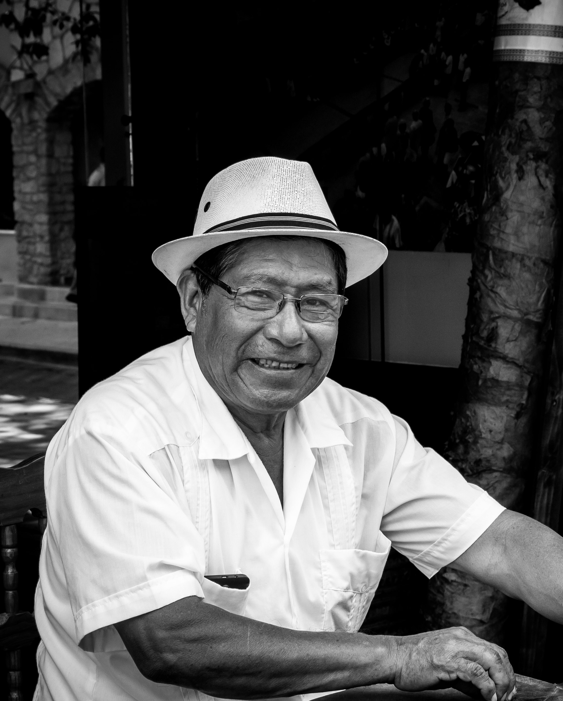
Health Disparities and Cultural Competence

Slide 2
Health Disparities and Cultural Competence
George Reyes is a 62-year-old male who came to the United States 12 years ago from Mexico with his son and daughter.
His lives alone but his daughter typically accompanies him to his clinic appointments. He owns his own brick laying company. He works full-time and is often out on job sites working during the day.

Slide 3
Health Disparities and Cultural Competence
He is regularly seen at the All Access Health Clinic for a variety of health concerns. He has chronic hypertension and chronic back pain related to a fall he experienced ten years ago.
Today he is accompanied by his daughter, daughter-in-law and four grandchildren.
English is the second language for the adult family members. Mr. Reyes’ granddaughter Eleiyah is 12 years old and is translating for the family.

Slide 4
Health Disparities and Cultural Competence
Through his granddaughter’s translation, Mr. Reyes reports he is in the clinic today because his eye hurts. It is red and has yellow drainage.
He says he has been working a lot, it’s very hot outside. He is very tired and always thirsty. He notices that his pants seem to be getting too big.

Slide 5
Health Disparities and Cultural Competence
It’s a very busy clinic day and the nurse is behind.
Rather than calling the language line, the nurse chooses to continue to use Mr. Reyes’ granddaughter as a translator.
The nurse completes her assessment, including VS
P=76
T=37.0 (98.6 F)
R=20
BP=140/90
Wt:180.5 lbs., (81.9 kg)
Ht=5’7”
Given the language barrier and the chaos with all of the family present the nurse does not ask Mr. Reyes about his fatigue. She does not review his current medications with the family. She also does not ask about the management of high blood pressure.
According to the documentation from his last visit he is prescribed Lisinopril 10 mg once daily by mouth for his high blood pressure.

Slide 6
Health Disparities and Cultural Competence
The physician diagnoses Mr. Reyes with bacterial conjunctivitis (pink eye).
Mr. Reyes is prescribed Gentamicin sulfate antibiotic eye drops.
Two drops to left eye twice daily for ten days.
The nurse hands the prescription to the granddaughter and asks her to tell her grandfather to put two drops in his left eye twice daily. The nurses asks if he understands.
Mr. Reyes nods his head and the family leaves the clinic.

Slide 7
Health Disparities and Cultural Competence
What type of health disparity has Mr. Reyes experienced?

Slide 8
Health Disparities and Cultural Competence
What factors contributed to Mr. Reyes not receiving the standard of care?

Slide 9
Health Disparities and Cultural Competence
What additional assessments should have been completed at this visit?

Slide 10
Health Disparities and Cultural Competence
What additional education could have been completed at this time?

Slide 11
Health Disparities and Cultural Competence
Mr. Reyes returns to the clinic one week later. He is accompanied by his daughter and four grandchildren.
He said his eye is red again and has yellow drainage.
You are the nurse this weekend. You assess Mr. Reyes and take his VS.
P: 68
T: 37.0 (98.6 F)
R: 19
BP: 130/90
Weight: 180 lbs. (81.6 kg)
Height: 5’7”
You recognize the adult members of the family do not speak English and decide to call the language line.

Slide 12
Health Disparities and Cultural Competence
You call the translation hotline the clinic uses for translation services.
You complete your history using the translation services.
You learn that Mr. Reyes always “feels” thirsty. You review his 24 hour food history. He reports his appetite has not decreased. He keeps eating but noticed his clothes are too big for him.
He wasn’t sure how to take the eye drops. He was putting two drops in both eyes twice daily. He quit using the eye drop three days ago because his eye wasn’t red anymore.
He says he takes his medication for his blood pressure when he “feels” like his blood pressure is high.
You compare his weight to previous visits and note he has lost almost 20 pounds over the past six month.

Slide 13
Health Disparities and Cultural Competence
Objective Data
General Appearance: Resting in chair, talking to family, no acute distress noted.
RESP: Not Assessed
CARDIAC: Skin pink, warm and dry to touch. Capillary refill <3 seconds.
NEURO: Alert & oriented to person/place/time/situation.
GI: Not Assessed
GU: Not Assessed
SKIN: Left eye is red with purulent drainage. No discharge noted to right eye. No other lesions noted. Lips moist.

Slide 14
Communication
You prepare to brief the Dr. Smith to see the patient.
What information is significant from Mr. Reyes history and assessment?
What information is important for you to share with the physician?
Practice SBAR

Slide 15
Health Disparities and Cultural Competence
Dr. Smith is concerned Mr. Reyes may have Type 2 Diabetes Mellitus.
You take his FSBS. It is 290 mg/dL.
You have collected appropriate lab to confirm the possible diagnosis of Type II Diabetes.
The physician has prescribed Glyburide.
You explain how to used the medication. Utilizing the translator, you allow Mr. Reyes to repeat the instructions back to you.
You have assisted in scheduling an appointment for Mr. Reyes to meet with an endocrinologist to confirm the diagnosis. You have also ensure he has an appointment with a diabetic educator and a dietician the following week.
Mr. Reyes scheduled to come back next week

Slide 16
Understandable Explanations

Slide 17
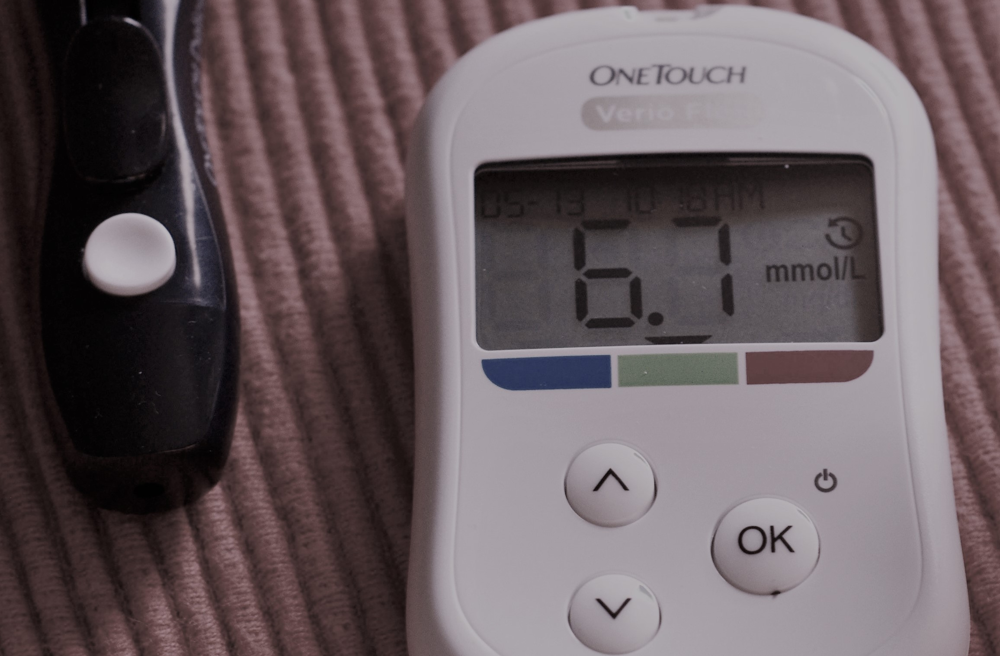
Understandable Explanations
How would you explain Finger Stick Blood Sugar to Mr. Reyes?

Slide 18
Communication
How do you choose a translator?

Slide 19
Communication
What are the key characteristics for an interpreter to possess?

Slide 20
Communication
What are the disadvantages of using a family member as an interpreter?

Slide 21
Communication
What strategies can you use to work with an interpreter?

Slide 22

Communicating With Peers
In healthcare, you will encounter situations that require you to communicate important information to other members of the healthcare team.
How would you recommend following up with the first nurse?

Slide 23
Communicating With Peers
How would you recommend following up with the first nurse?
C-I am concerned.
U-I am uncomfortable.
S-This is a safety issue.
https://www.ahrq.gov/professionals/quality-patient-safety/hais/tools/ambulatory-surgery/sections/implementation/training-tools/cus-tool.html
Practice with a classmate.

Slide 24
Communicating With Peers
What additional actions are appropriate?

Slide 25
References
References
Lewis, S. L., Dirksen, S. R., Heitkemper, M. M., Bucher, L., & Camera, I. M. (2011). Medical-surgical nursing: Assessment and management of clinical problems (8th ed.). St. Louis, MO: Elsevier.
LeMone, P., Burke, K. M., Bauldoff, G., & Gubrud-Howe, P. M. (2015). Medical-surgical nursing: clinical reasoning in patient care. Sixth edition. Boston: Pearson.

Slide 26
THE END

