Slide 1
Altered
neurological function

Slide 2
Patient Profile
Jaylee Kraft is a 19-year-old African American college student.
She arrived to the emergency department where you work.
She was accompanied by two of her friends.

Slide 3
Subjective data From Friends
Jaylee moved in with the family of some friends a few weeks ago to save money.
She is known to be an attentive student.
Jaylee is majoring in photography and has a side business taking advertising photos for local businesses.
She loves hiking and taking outdoor pictures.
She is usually very “easy going.”

Slide 4
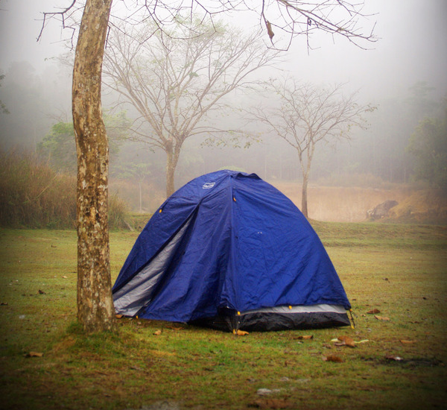
Subjective Data From Friends
The friends were on an overnight hiking trip.
They camped Saturday night and the three friends shared a tent together.
Jaylee seemed fine on Saturday.

Slide 5
Subjective Data From Friends
During their Sunday hike Jaylee complained about the bright sunlight and borrowed her friend’s hat to help block the sunlight.
She had trouble using her camera.
She complained her neck was stiff and took very few pictures.
She finally decided to go back to the campsite and wait for her friends there.
A few hours later the friends arrived back to the campsite to find Jaylee laying in the tent. She was uncomfortable and extremely irritable.
Jaylee complained of a severe headache. She was sweating, had chills, and seemed to have a temperature.
The friends decided to take her to a local emergency department.

Slide 6
You ask Jaylee’s friends to leave the room while you speak to Jaylee privately to ensure you have permission for them to be in the room.
Jaylee becomes impatient and snaps at you for demanding her friends leave the room. Looking very concerned, one of her friends explains that she doesn’t usually act like this.
With Jaylee’s permission you proceed with bedside handover. The friends share the details about the weekend and Jaylee’s typically pleasant demeanor.

Slide 7
Objective data
During bedside handover you note that Jaylee is extremely agitated and is at times confused.
She has dry mucous membranes, cracked lips and small petechiae over the upper torso and abdomen.
Her temperature is 40.0$℃$ (104˚$F)$, BP 130/74, RR 22, HR 86.

Slide 8
ASSESSING
Based on your assessment and the Jaylee’s history, what concerns you the most?
What are your top priorities?
What diagnosis do you suspect?

Slide 9
Bacterial Meningitis
What symptoms lead you to believe Jaylee may have bacterial meningitis?

Slide 10
Bacterial Meningitis
What orders do you expect to receive and why?

Slide 11
Bacterial Meningitis
How will you implement droplet precautions?

Slide 12
Diagnostic test results
Jaylee’s Diagnostic Test Results are back:
LP-results are pending but the CSF was turbid and cloudy.
CBC results: white count is elevated.

Slide 13
Communication
What education is essential to provide to Jaylee’s friends and family?

Slide 14
Interpreting
What symptoms and complications do you anticipate Jaylee may experience?

Slide 15
Responding: Communication
You prepare to call report to RN Ami Smith:
You have learned that Jaylee lives with a young couple and they have two small children. Jaylee spends a lot of time with them.
Jaylee’s LOC has decreased since arrival to the Emergency Department. She is agitated and confused.
Soft wrist restraints are ordered bilaterally.
No family at bedside.
CSF elevated protein and decreased glucose.
Blood cultures sent.
Received one dose of IV Ampicillin.
One seizure lasting approximately 45 seconds.
IVF’s: LR @ 50 ml/hour.

Slide 16
Communication What information will you include in BS handover?
Practice SBAR:
S
SITUATION
B
BACKGROUND
A
ASSESSMENT
R
RECOMMENDATION

Slide 17
Communication - SBAR
Based on the information you have what information will you include when you call report.
Practice using the SBAR format.

Slide 18
Communication - SBAR
Situation:

Slide 19
Communication - SBAR
Background:

Slide 20
Communication - SBAR
Assessment:

Slide 21
Communication - SBAR
Recommendation:

Slide 22
Medication orders
Nurse Smith is the RN is assuming care of Miss Kraft in the ICU.
What medication orders can she anticipate and why?

Slide 23
Medication orders
Jaylee has been prescribed codeine.
Why was this medication ordered?
What side effect of codeine are you concerned about?

Slide 24
What nursing interventions Will nurse smith expect?

Slide 25
How is viral meningitis different than bacterial meningitis?

Slide 26
Interpreting: Discharge planning
What will be important considerations for discharge planning?

Slide 27
References
References
Lewis, S. L., Dirksen, S. R., Heitkemper, M. M., Bucher, L., & Camera, I. M. (2011). Medical-surgical nursing: Assessment and management of clinical problems (8th ed.). St. Louis, MO: Elsevier.
LeMone, P., Burke, K. M., Bauldoff, G., & Gubrud-Howe, P. M. (2015). Medical-surgical nursing: clinical reasoning in patient care. Sixth edition. Boston: Pearson.
Pathan N, Faust SN, Levin M (2003, July 1). Pathophysiology of meningococcal meningitis and septicaemia. Archives of Disease in Childhood, 88, 601-607. doi: 10.1136/adc.88.7.601.

Slide 28
THE END

